Slide 1
Name : Sowmiya Sree G Reg.no : 730321104052 NM id : au730321104052 Degree : B.E - CSE Year : III College name : Builders Engineering College
3/21/2024 Annual Review

Slide 2
PROJECT TITLE
Image Classification using CNN on Fashion MNIST Dataset
3/21/2024 Annual Review

Slide 3


AGENDA
Problem statement
Project Overview
Who are the end users
Your solution and its value proposition
The Wow in your solution
Modeling
Results
3/21/2024 Annual Review

Slide 4

PROBLEM STATEMENT
The goal is to leverage Convolutional Neural Networks (CNNs) to create a robust image classification system capable of achieving high accuracy on unseen data.
3/21/2024 Annual Review

Slide 5

PROJECT OVERVIEW
Task: Build a CNN model for classifying grayscale fashion item images into ten categories.
Dataset: Fashion MNIST with 60,000 training and 10,000 test examples.
Image Size: Each image is 28x28 pixels.
Approach: Utilize deep learning techniques.
Objective: Develop an accurate image classification system.
3/21/2024 Annual Review

Slide 6

WHO ARE THE END USERS?
Researchers in Computer Vision
Machine Learning Practitioners
Fashion Retailers and E-commerce Platforms
General Audience Interested in AI
Educators and Students
3/21/2024 Annual Review

Slide 7

YOUR SOLUTION AND ITS VALUE PROPOSITION
Solution:
Develop a CNN model for Fashion MNIST dataset to classify grayscale fashion items. Includes exploration, preprocessing, architecture design, training, evaluation, and visualization. Aims for high accuracy through deep learning techniques for robust image classification.
Value Proposition:
Efficient Image Classification
Scalability
Improved Decision Making
Resource Optimization
Educational Resource
Benchmarking Tool
3/21/2024 Annual Review

Slide 8

THE WOW IN YOUR SOLUTION
The "wow" factor in the solution for the "Image Classification using Convolutional Neural Networks (CNNs) on Fashion MNIST Dataset" project lies in its ability to achieve remarkable accuracy and efficiency in classifying fashion items from images. Here's why it's impressive:
Near-Human Accuracy
Real-Time Classification
Generalization
User-Friendly Interface
Potential Business Impact
State-of-the-Art Technology
3/21/2024 Annual Review
8

Slide 9
MODELLING
Teams cam add wireframes
Data Loading and Preprocessing
Define Model Architecture
Convolutional Layers
Pooling Layers
Fully Connected Layers
Model Compilation
Model Training and Evaluation
Fine-Tuning
3/21/2024 Annual Review
9

Slide 10
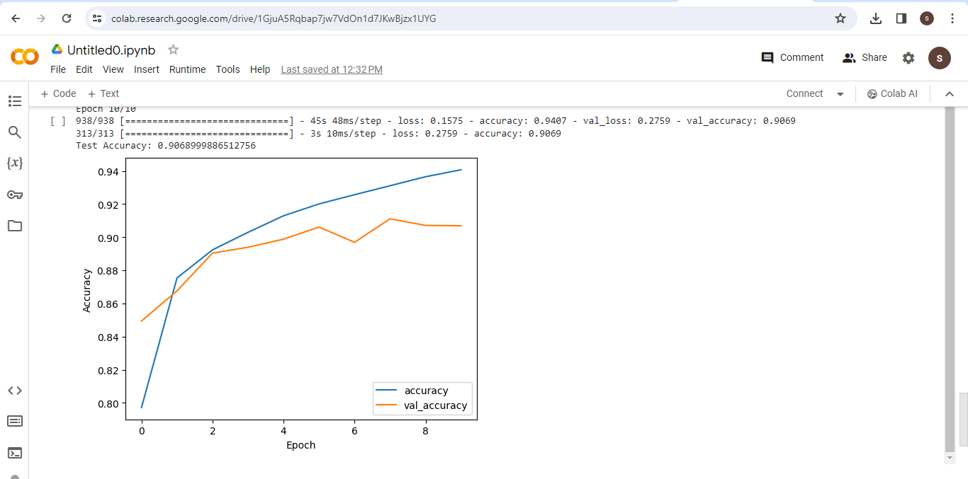
RESULTS
3/21/2024 Annual Review
10

